Slide 1
ISAM B+ Trees
in DBMS

Slide 2
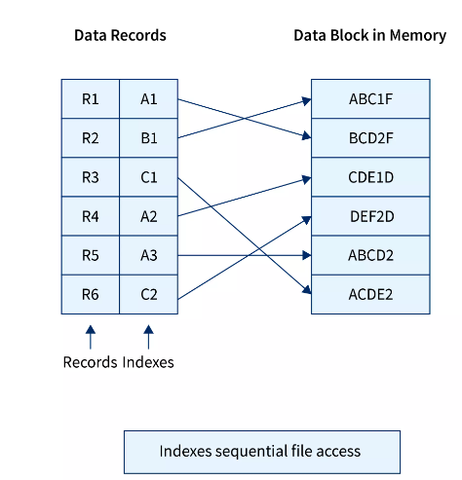
ISAM-Indexed Sequential Access Method
This method is an advanced file organization in DBMS in which for each record in a file, an index value is generated from its primary key, and that index value is mapped with the record, this index contains the address of the record as shown below:

Slide 3
ISAM-Advantages:
Since there is an index corresponding to each record in the table, it is quicker to access any record in the memory, hence ISAM file organization in DBMS can be used for managing large databases.
Range retrieval and partial retrieval are possible in this method since the index is generated from the key value column we can generate the record addresses of a range of key values, also when a partial key is provided, like student names starting with "RA '' can also be searched efficiently.

Slide 4
ISAM-Disadvantages:
The main disadvantage is that it takes a lot of space for storing index values; hence when the records increase in number the number of indexes also increases.
When the new records are inserted, then these files have to be reconstructed to maintain the sequence.
When the record is deleted, then the space used by it needs to be released. Otherwise, the performance of the database will slow down.

Slide 5
B+ Tree
A B+ Tree is a more advanced self-balancing tree.
All the values are present at the leaf level.
B+ Tree in the data structure is a B Tree enhancement that enables faster insertion, deletion, and search operations.

Slide 6
B+ tree
It is a balanced binary search tree.
It follows a multi-level index format.
In the B+ tree, leaf nodes denote actual data pointers.
B+ tree ensures that all leaf nodes remain at the same height.
In the B+ tree, the leaf nodes are linked using a link list.
Therefore, a B+ tree can support random access as well as sequential access.

Slide 7
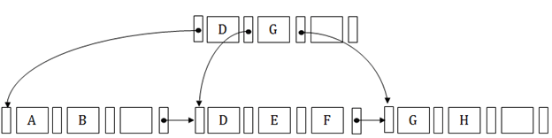
Structure of B+ Tree
In the B+ tree, every leaf node is at equal distance from the root node. The B+ tree is of the order n where n is fixed for every B+ tree.
It contains an internal node and leaf node.

Slide 8
B+ Tree
Internal node
An internal node of the B+ tree can contain at least n/2 record pointers except the root node.
At most, an internal node of the tree contains n pointers.
Leaf node
The leaf node of the B+ tree can contain at least n/2 record pointers and n/2 key values.
At most, a leaf node contains n record pointer and n key values.
Every leaf node of the B+ tree contains one block pointer P to point to next leaf node.

Slide 9
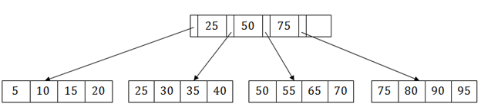
Searching a record in B+ Tree
Suppose we have to search 55 in the above B+ tree structure. First, we will fetch for the intermediary node which will direct to the leaf node that can contain a record for 55.
So, in the intermediary node, we will find a branch between 50 and 75 nodes. Then at the end, we will be redirected to the third leaf node. Here DBMS will perform a sequential search to find 55.

Slide 10
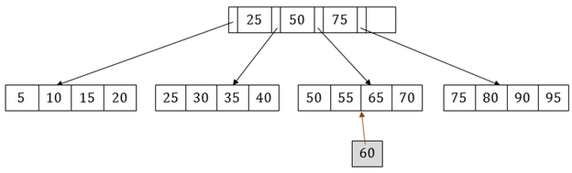
B+ Tree Insertion
Suppose we want to insert a record 60 in the below structure. It will go to the 3rd leaf node after 55. It is a balanced tree, and a leaf node of this tree is already full, so we cannot insert 60 there.
In this case, we have to split the leaf node, so that it can be inserted into tree without affecting the fill factor, balance and order.

Slide 11
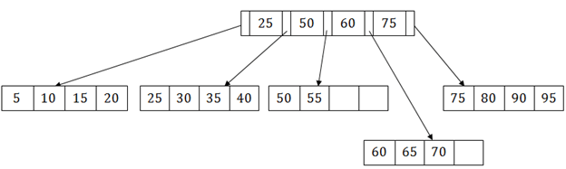
B+ Tree Insertion
The 3rd leaf node has the values (50, 55, 60, 65, 70) and its current root node is 50. We will split the leaf node of the tree in the middle so that its balance is not altered. So we can group (50, 55) and (60, 65, 70) into 2 leaf nodes.
If these two has to be leaf nodes, the intermediate node cannot branch from 50. It should have 60 added to it, and then we can have pointers to a new leaf node.

Slide 12
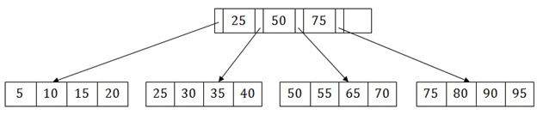
B+ Tree Deletion
Suppose we want to delete 60 from the above example. In this case, we have to remove 60 from the intermediate node as well as from the 4th leaf node too. If we remove it from the intermediate node, then the tree will not satisfy the rule of the B+ tree. So we need to modify it to have a balanced tree.
After deleting node 60 from above B+ tree and re-arranging the nodes

